Slide 1
Doubly Convolutional Neural Networks
CNN RESEARCH PROJECT
MNNIT-ALLAHABAD
ARYAN KARN (20185106)

Slide 2
AIM
Parameter sharing is the major reason of success of building large models of CNN for deep neural networks. This paper introduces the idea of Doubly Convolutional Neural Networks, which significantly improves the performance of CNN with the same number of parameters and improving the speed.

Slide 3
RESEARCH PROPOSED BY:
Shuangfei Zhai : Binghamton University
Yu Cheng : IBM T.J. Watson Research Center
Weining Lu : Tsinghua University
Zhongfei (Mark) : Zhang Binghamton University
ABSTRACT:
Building large models with parameter sharing accounts for most of the success of deep convolutional neural networks (CNNs). In this paper, we propose doubly convolutional neural networks (DCNNs), which significantly improve the performance of CNNs by further exploring this idea. Instead of allocating a set of convolutional filters that are independently learned, a DCNN maintains groups of filters where filters within each group are translated versions of each other. Practically, a DCNN can be easily implemented by a two-step convolution procedure, which is supported by most modern deep learning libraries.

Slide 4
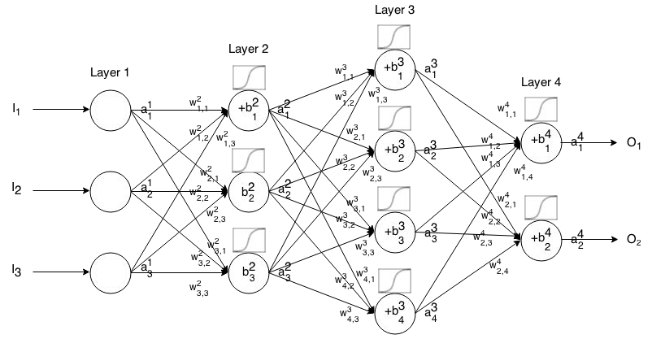
Neural Network

Slide 5
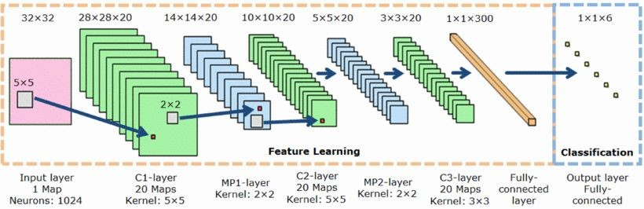
Convolutional Neural network
CNNs are extremely parameter efficient due to exploring the translation invariant property of images, which is the key to training very deep models without severe overfitting.

Slide 6
K-Translation Correlation
In well trained CNNs, many of the learned filters are slightly translated versions of each other.
K-translation correlation between two convolutional filters within same layer W_{i}, W_{j} is defined as:
Here, T(.,x,y) denotes the translation of the first operand by (x,y) along its spatial dimensions.
K-translation correlation between a pair of filters indicates the maximum correlation achieved by translating filters up to k steps along any spatial dimension.
For deeper models, averaged maximum k-translation correlation of a layer W is:
N is the number of filters

Slide 7
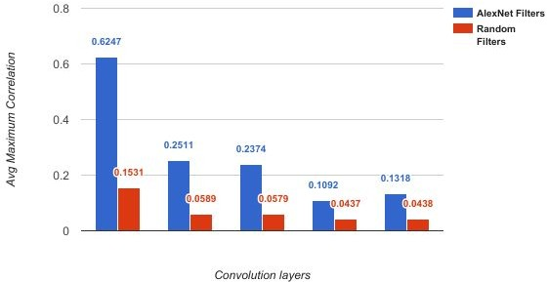
Correlation Results
The averaged maximum 1-translational correlation of each layer for AlexNet and VGG Net are as follows. As a comparison, a filter bank with same shape filled with random gaussian samples has been generated.
ALEXNET LAYERS

Slide 8
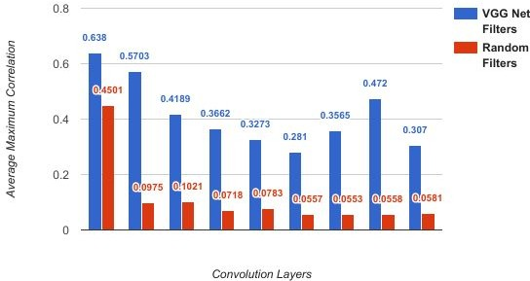
VGG-19 first nine layers

Slide 9
Group filters which are
translated versions of each other.
DCNN allocates a set of meta filters
Idea of DCNN
Convolve meta filters with identity kernel
Effective filters extracted

Slide 10
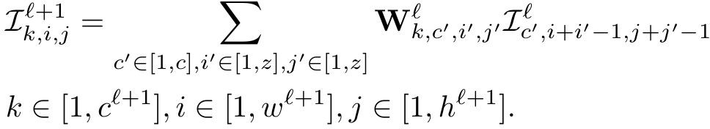
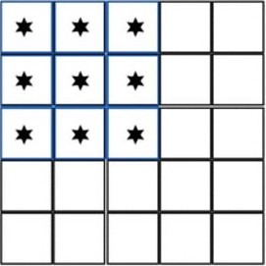



Convolution
Input image:
Set of c_{l+1} filters :
Output image:
each filter of shape: c^{l} x z x z

Slide 11
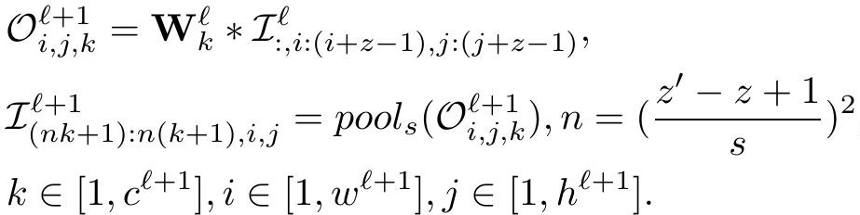


Double Convolution
Input image:
Output image:
Set of c^{l+1} meta filters:
with filter size z’xz’, z’>z
Spatial pooling function with pooling size s x s

Slide 12
Set of c^{l+1} meta filters size (z’ x z’)
Image patches size (z x z) convolved with each meta filter
Output size (z’-z+1) x (z’-z+1)
Working of DCNN
Spatial pooling with size (s x s)
Output flattened to column vector
Feature map with nc^{l+1} channels

Slide 13
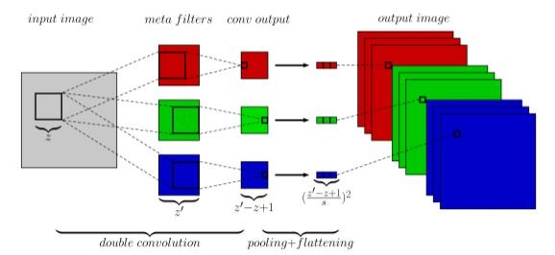
Double Convolution: 2 step convolution
STEP1:
An image patch is convolved with a metafilter.
STEP2:
Meta filters slide across to get different patches, i.e. convolved with the image.

Slide 14
ALGORITHM-

Slide 15
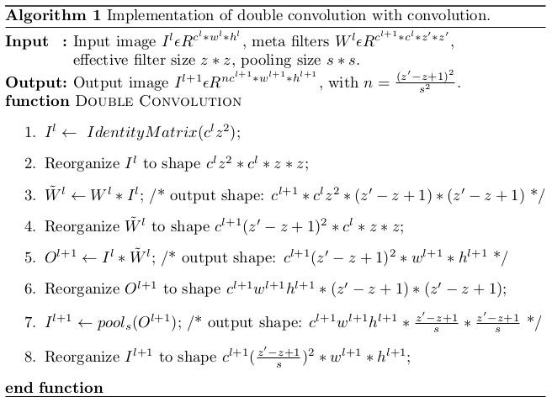

Slide 16
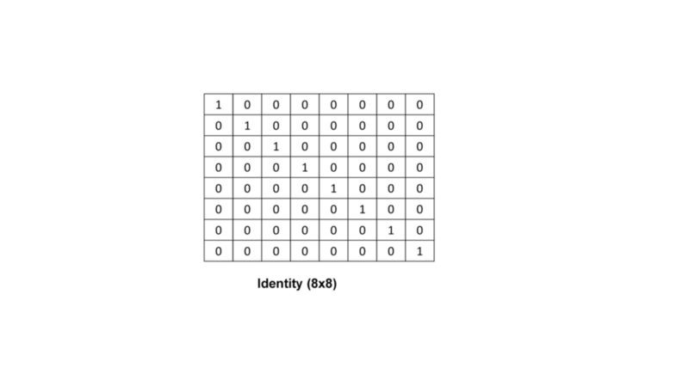

Slide 18
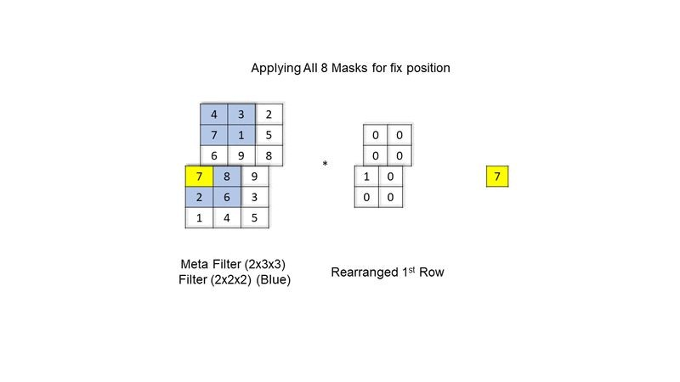

Slide 20
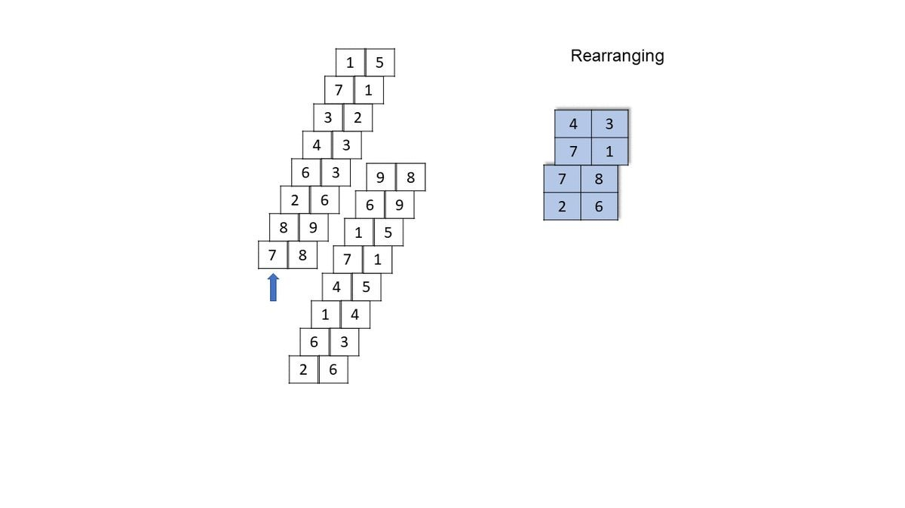

Slide 22
Implementation & Results

Slide 23
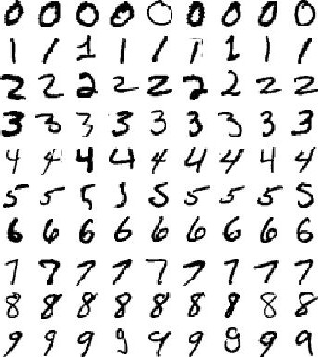
MNIST DATASET
Input: 1x28x28 (GrayScale Image)
Class: 10 (0,1,2, … , 9)
Train Samples: 60,000
Test Samples: 10,000

Slide 24
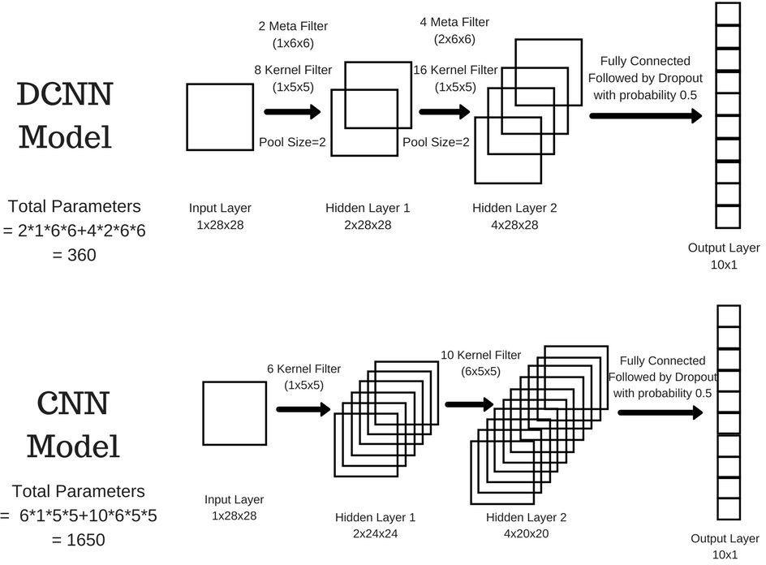

Slide 25
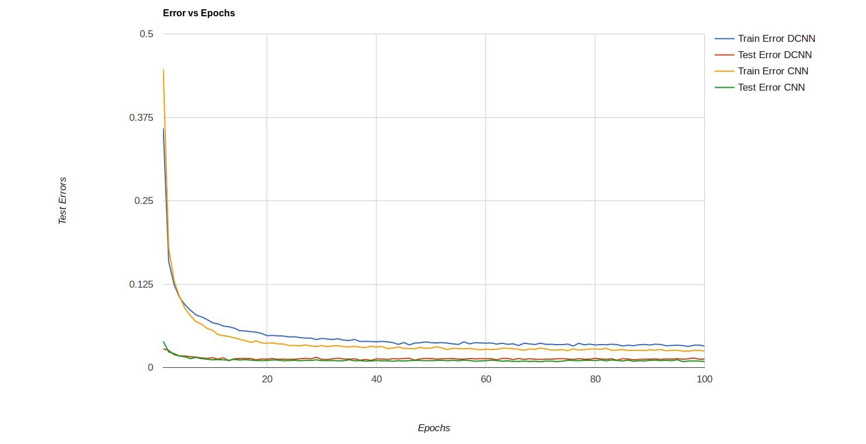
Batch Size: 200 Epochs: 100 Dropout: Yes
Minimum Error Values:
DCNN Train: 0.032 at 97
DCNN Test: 0.01 at 13
CNN Train: 0.025 at 97
CNN Test: 0.009 at 70

Slide 26
DCNN vs CNN
Epochs | Pool | Batch Size | Dropout | Test Error DCNN | Test Error CNN
10 | 2 | 200 | No | 0.0137 | 0.019
9 | 1 | 100 | No | 0.018 | 0.017
10 | 2 | 200 | Yes | 0.0153 | 0.0171
Conclusion:
Even though DCNN has 360 params compare to CNN which as 1650 params, Test Error is almost comparable.
Forward Pass Run is Faster in DCNN.
Convergence for DCNN is much faster and after that overfitting happens quickly compare to CNN

Slide 27
Variants of DCNN
Standard CNN z’=z
DCNN is generalisation of CNN
Concat DCNN s=1
Maximally parameter efficient
Maxout DCNN s=z’-z+1
Output image channel size equal to the number of meta filters.
Yields a parameter efficient implementation of maxout network.
With the same amount of parameters produces (z’-z+1)²z²
z’²
times more channels for a single layer.

Slide 28
What’s Next?
Instead of translational correlation modeling for Rotational Correlation.
Mechanism to decide number of meta filters and its size.

Slide 29
References
GitHub: Aryan05
Doubly Convolutional Neural Networks (NIPS 2016) by Shuangfei Zhai, Yu Cheng,
Weining Lu and Zhongfei (Mark) Zhang
https://papers.nips.cc/paper/6340-doubly-convolutional-neural-networks.pdf
Getting Started with Lasagne: http://luizgh.github.io/libraries/2015/12/08/getting-started-with-lasagne/
Lasagne Docs: https://lasagne.readthedocs.io/en/latest/
Theano Docs: http://deeplearning.net/software/theano/library/index.html

